Slide 2
Media Report

Slide 3
Background
Tony Kirby PR Ltd hired to provide media services for ECO since 2012
Substantial coverage obtained across Europe and globally during this time
Newsletter service also provided to give delegates interesting material to read during the congress

Slide 4
Media highlights
For the third year in succession, a large group of UK national journalists attended the congress, due to the volume and quality of stories that had received in previous years.
Their widespread coverage has confirmed that although ECO may not be huge in terms of delegate numbers, it is firmly placed in the conference agenda of the main UK media.

Slide 5
Media highlights
This year's congress in Glasgow was very close to BBC Scotland, which meant that various BBC outlets could easily do interviews with key speakers
These included EASO President Dr Nathalie Farpour-Lambert, Local Chair Professor Mike Lean, and others.

Slide 6
Media highlights
The unusual start on a Sunday did not hinder coverage in any way.
Dr Charlotte Hardman (University of Liverpool) appeared on national BBC Television, while other stories appeared in Sunday UK and international press.

Slide 7
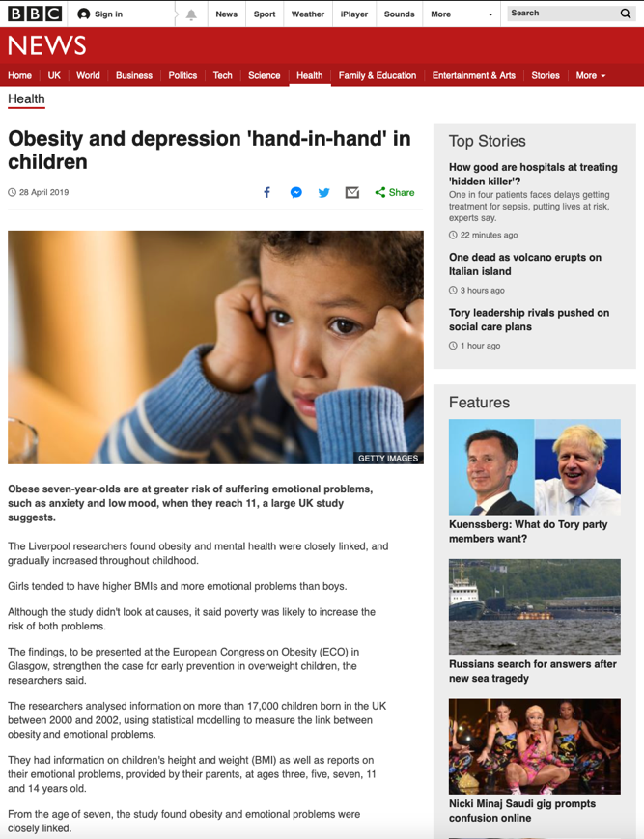
BBC News

Slide 8
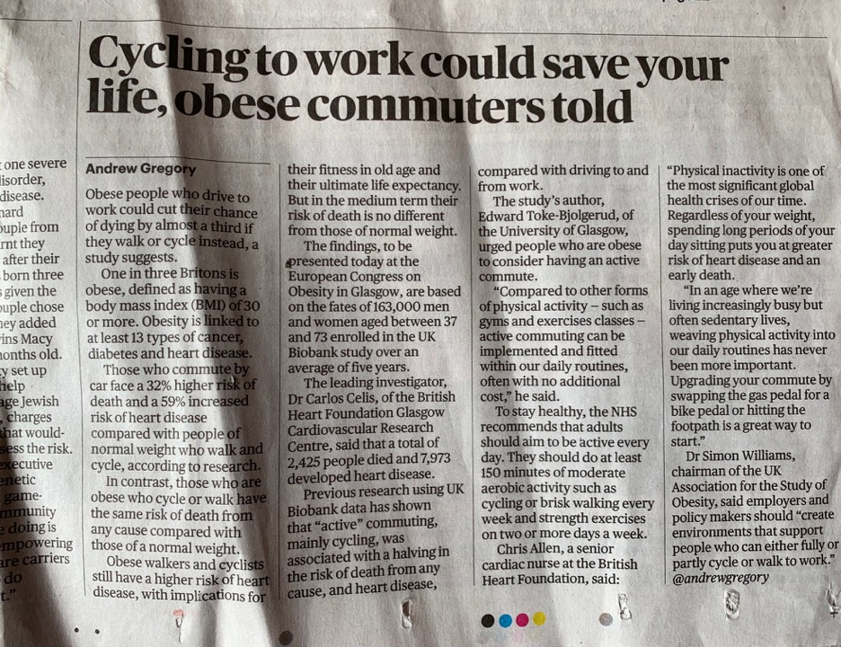
The Sunday Times

Slide 9
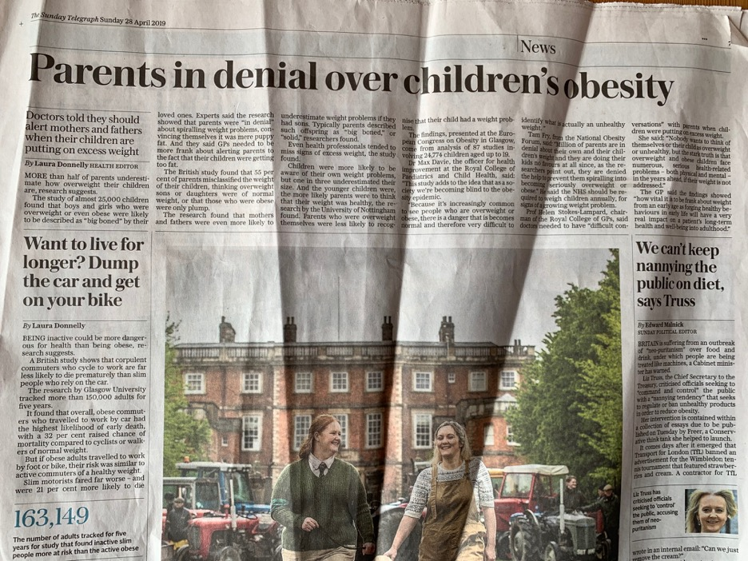
The Sunday Telegraph

Slide 10
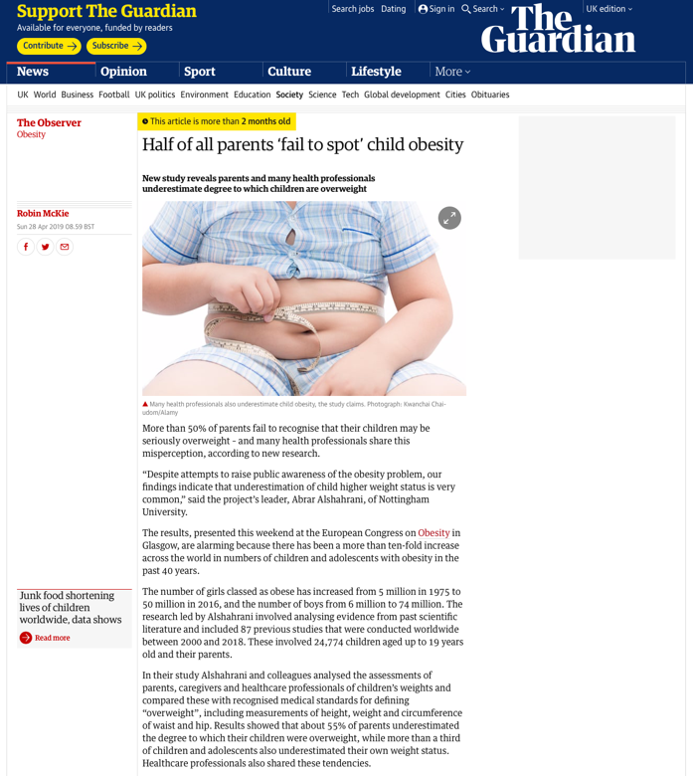
The Observer

Slide 11
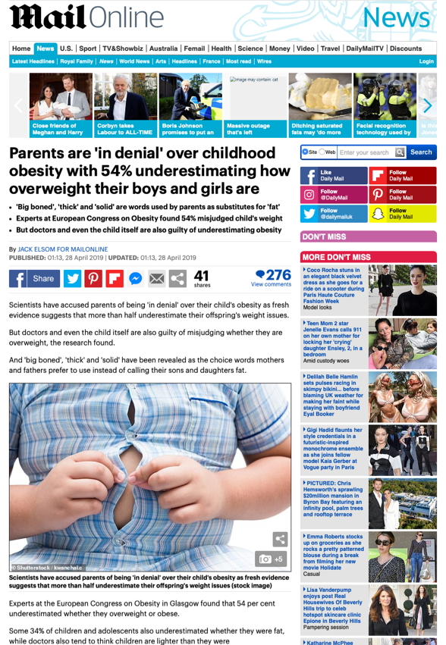
Daily Mail

Slide 12
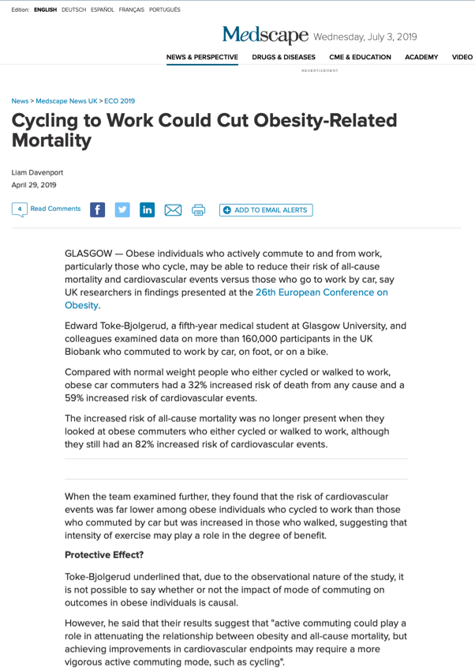
Medscape

Slide 13
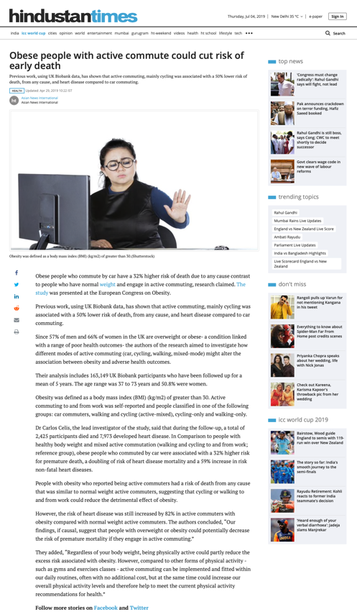
Hindustan Times

Slide 14
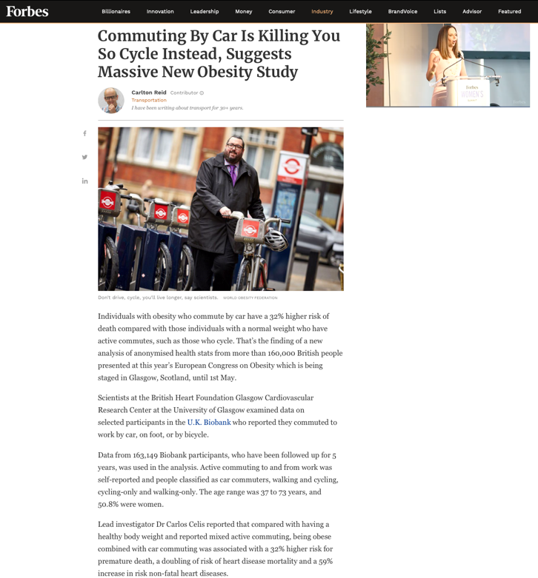
Forbes

Slide 15
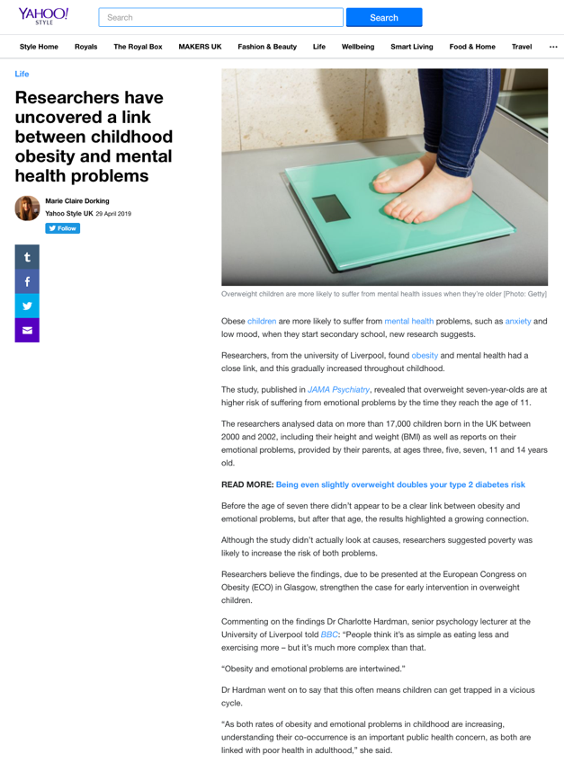
Yahoo! News

Slide 16
Media highlights
Coverage on Monday 29 April was among the best ever received by the congress, with three UK national newspapers covering the obesity outcomes study
Other stories also received pick-up around the world, with copy from the Press Association news agency also reaching UK and international outlets

Slide 17
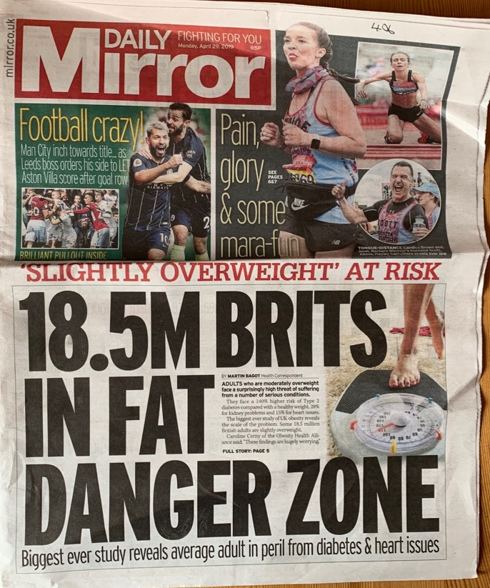
Daily Mirror

Slide 18
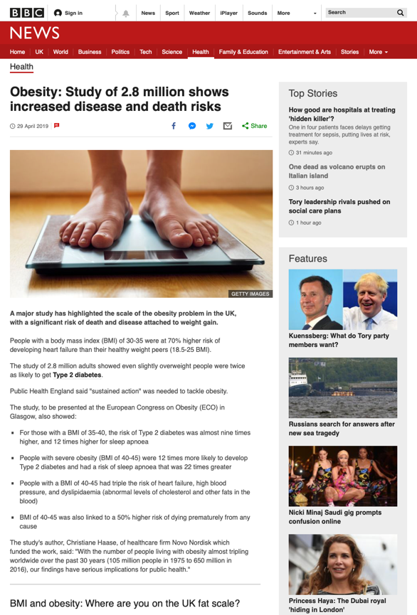
BBC News

Slide 19
Daily Mail

Slide 20
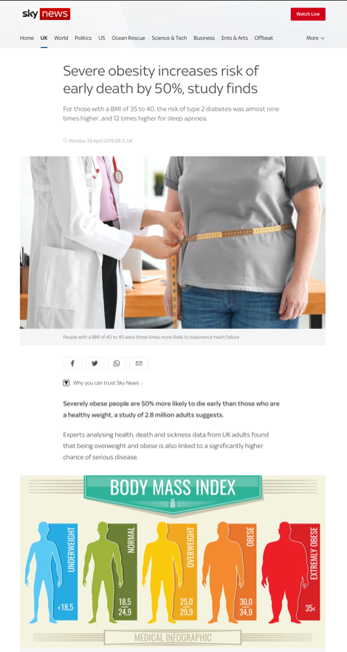
Sky News

Slide 21
Media highlights
There was extensive coverage of an abstract not covered in the press releases, on a swallowable gel pill that fills the stomach to combat obesity (a late breaking abstract)

Slide 22
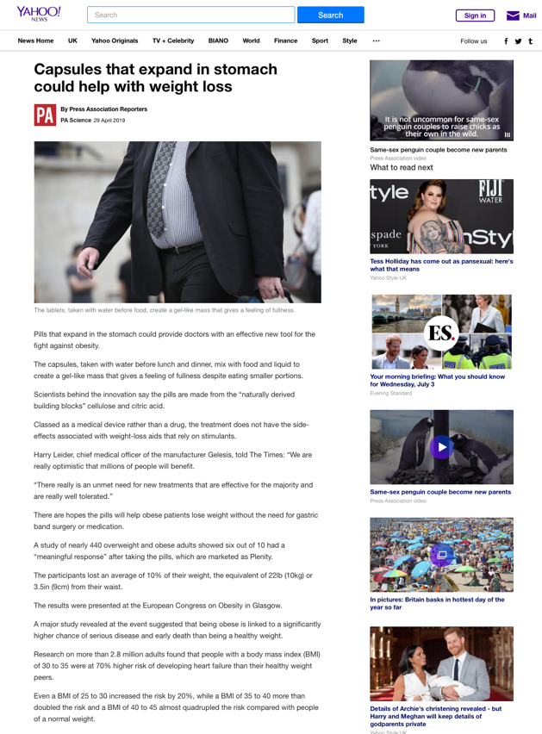
Yahoo! News

Slide 23
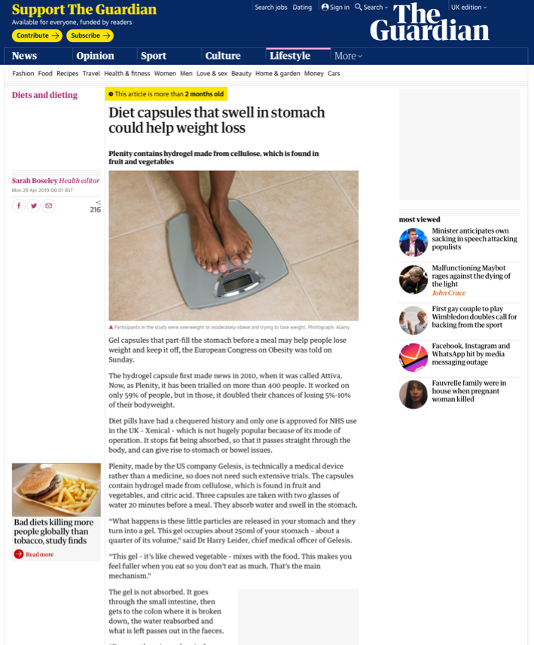
The Guardian

Slide 24
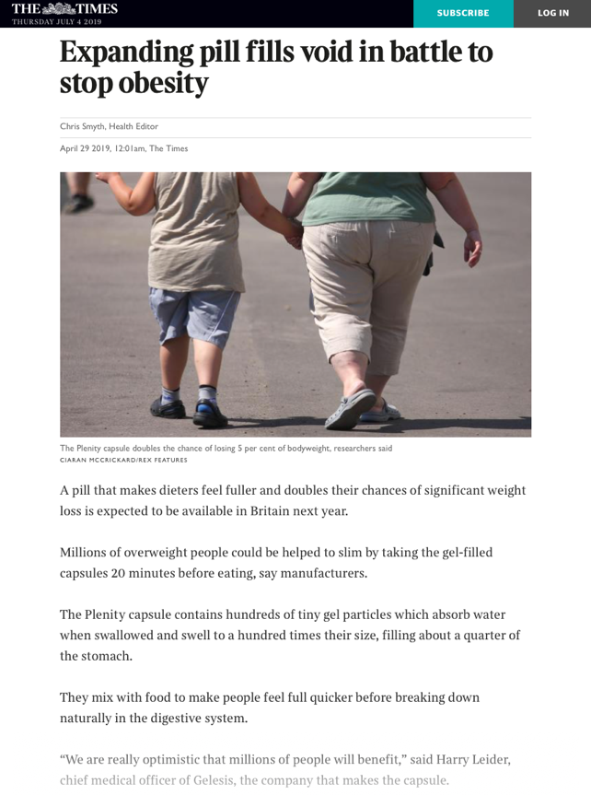
The Times

Slide 25
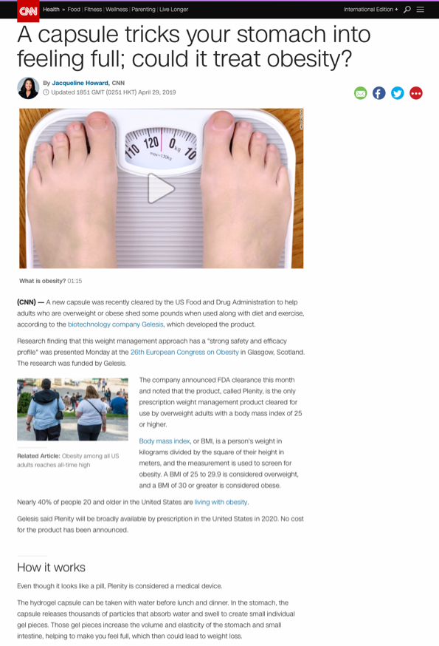
CNN

Slide 26
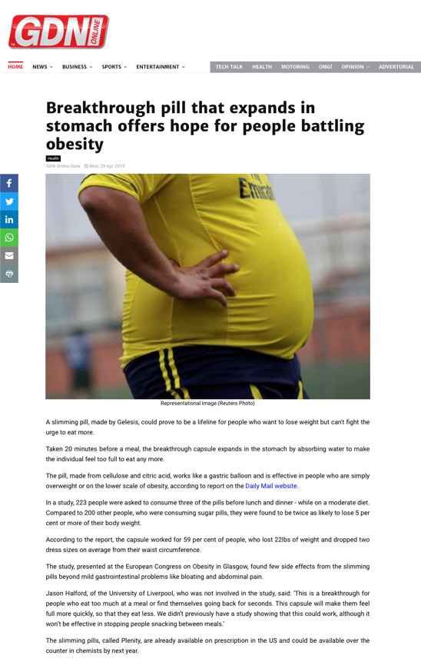
Gulf Digital News

Slide 27
Media highlights
Reducing sugar in tea was an abstract covered by the Press Association, which also received extensive coverage:

Slide 28
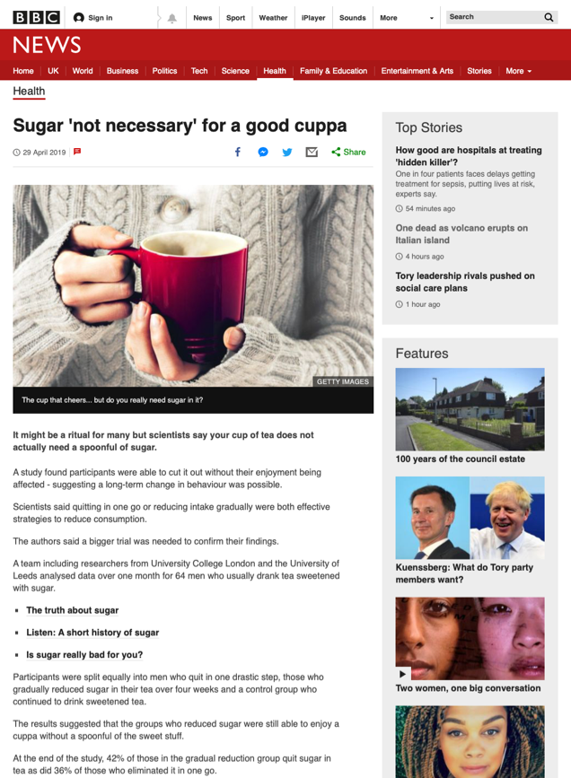
BBC News

Slide 29
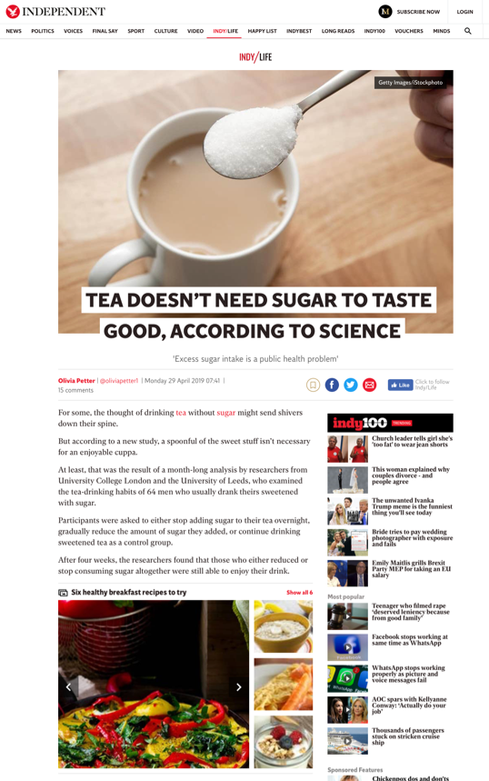
The Independent

Slide 30
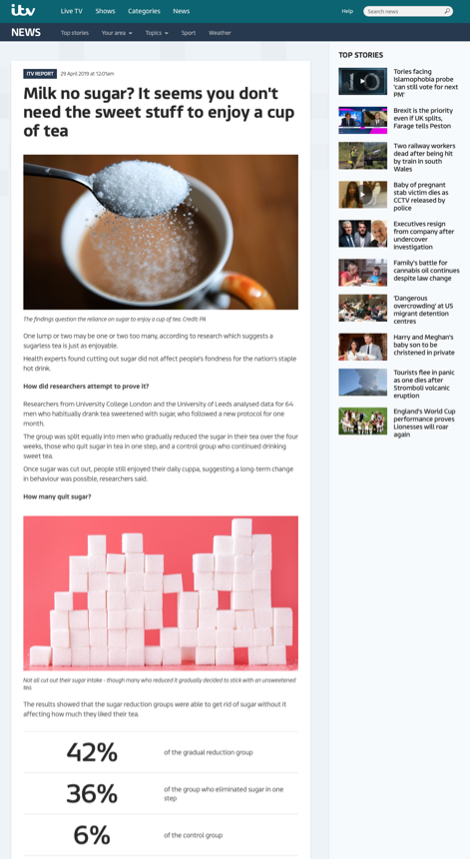
ITV

Slide 31
Media highlights
PA newswire story - Kidney cancer risk for tall, heavy kids

Slide 32
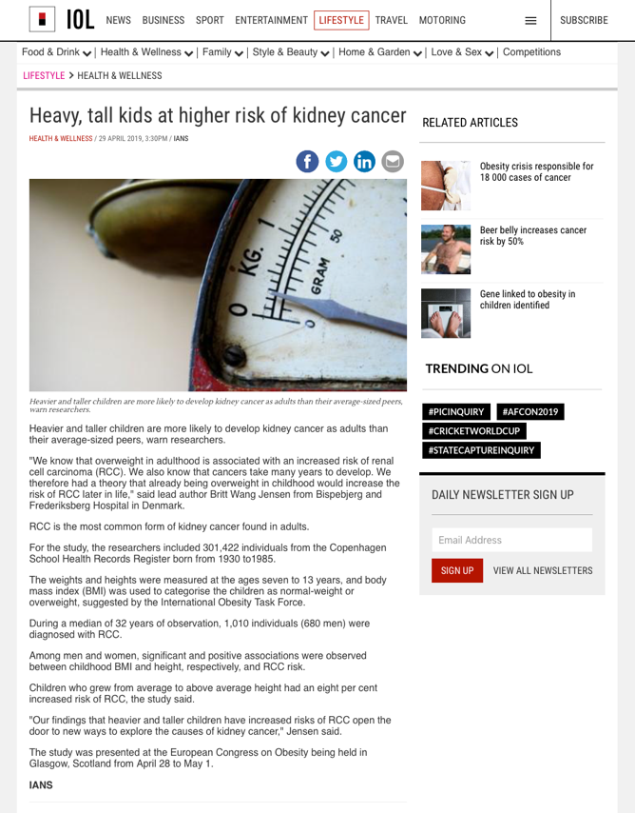
Independent Online (South Africa)

Slide 33
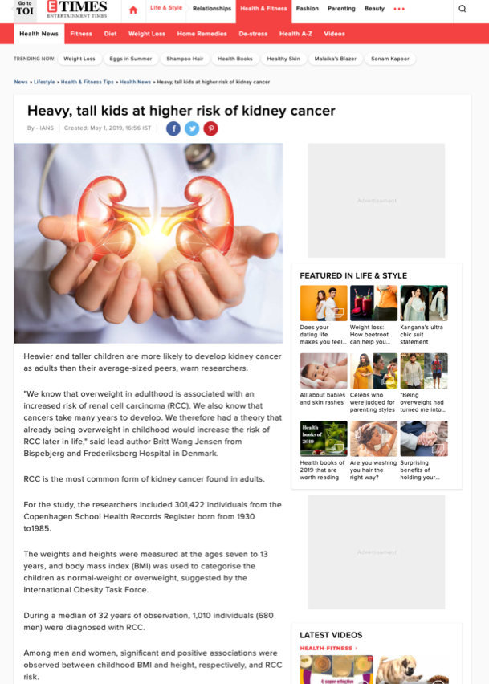
Times of India

Slide 34
Media highlights
BMI not measured enough in GP surgeries

Slide 35
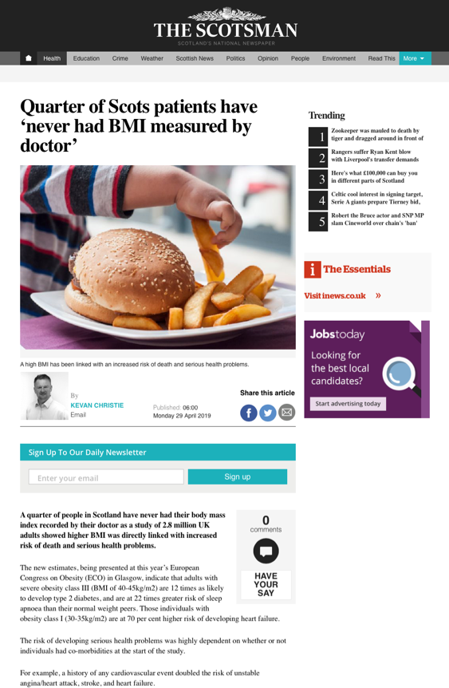
The Scotsman

Slide 36
Media highlights
On Tuesday April 30, the new research presented by WHO on breastfeeding and its link to child obesity was covered globally, by journalists present at the congress and also by the AFP and PA newswires.

Slide 37
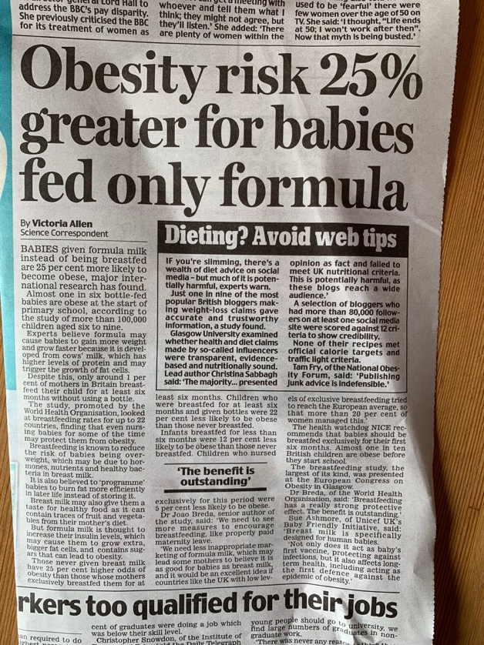
Daily Mail

Slide 38
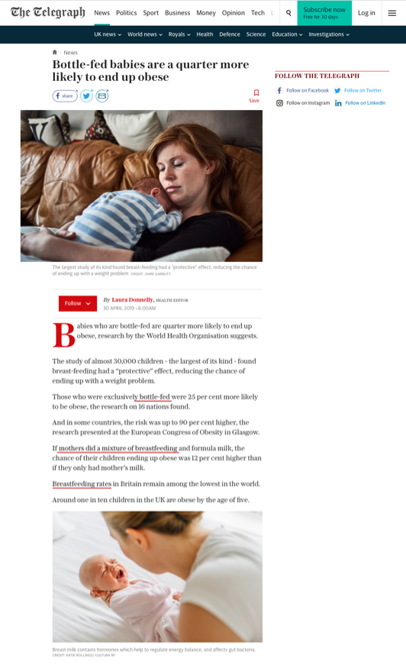
The Daily Telegraph

Slide 39
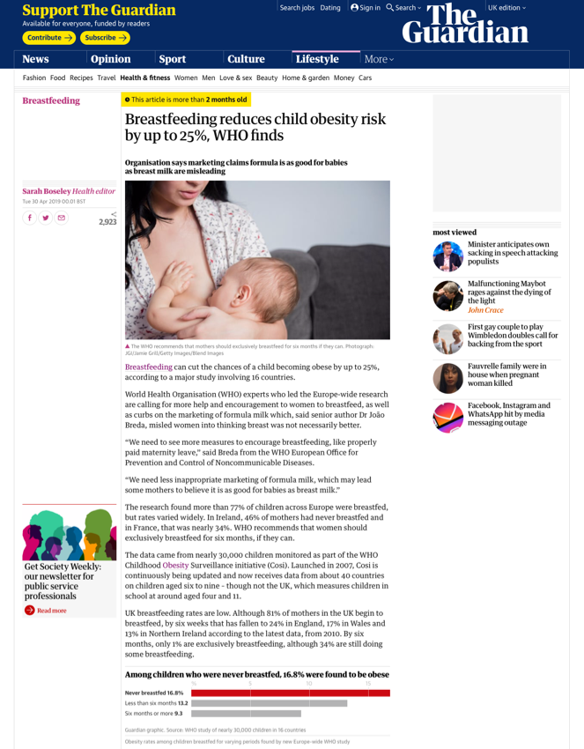
The Guardian

Slide 40
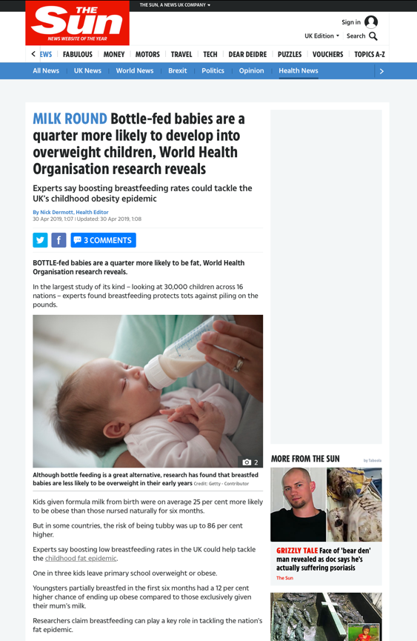
The Sun

Slide 41
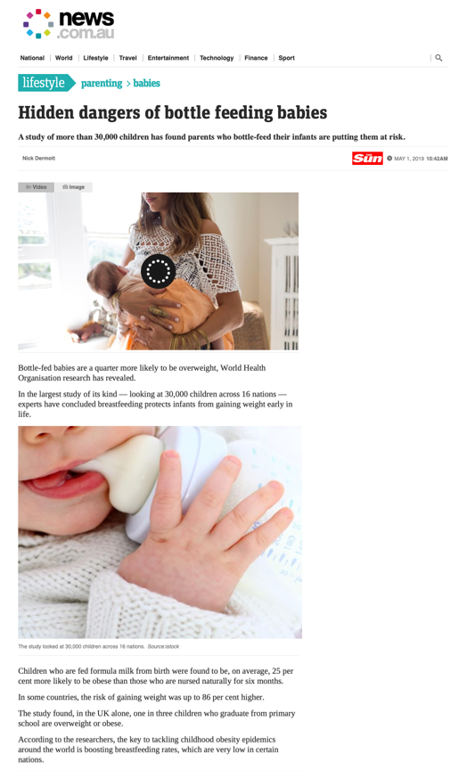
News.com.au (Australia)

Slide 42
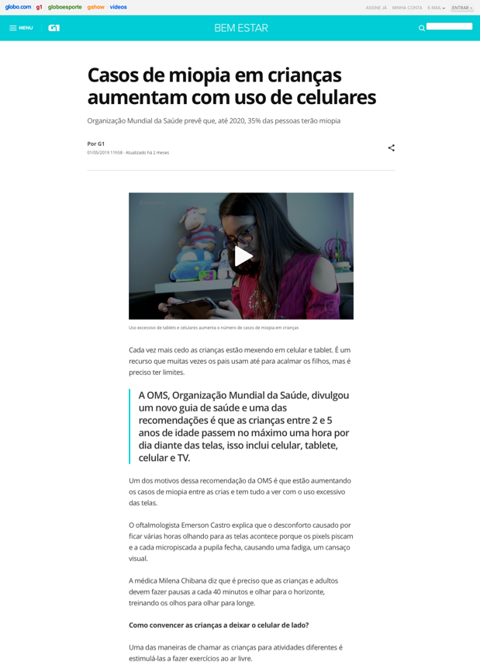
Globo News (Brasil)

Slide 43
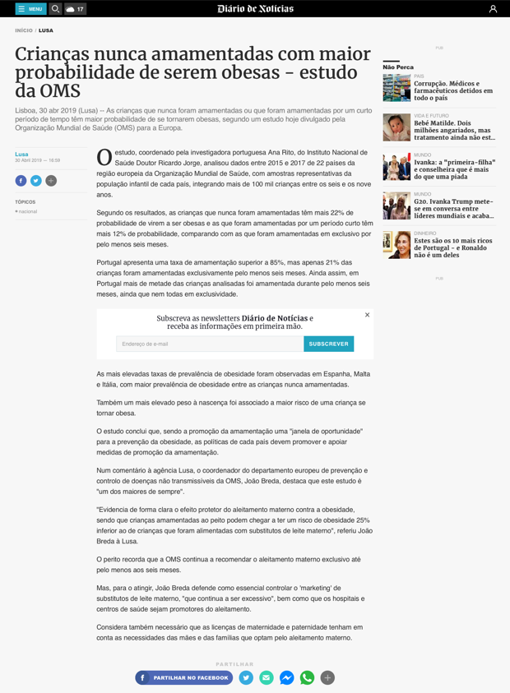
Diario de Noticias (Portugal)

Slide 44
Media highlights
Social media influencers

Slide 45
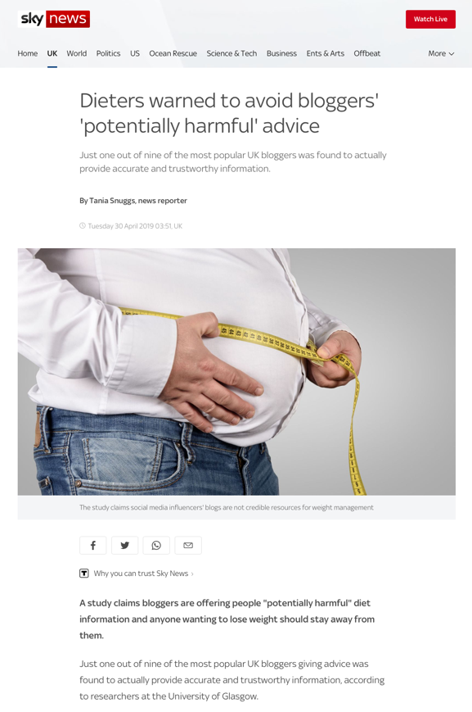
Sky News

Slide 46
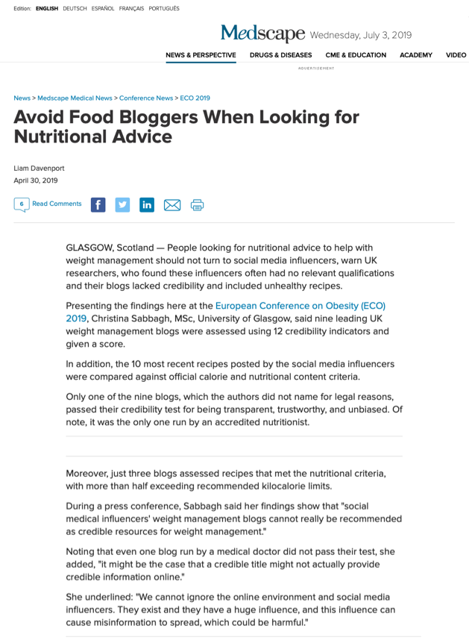
Medscape

Slide 47
Media highlights
Obesity rate in pregnant women doubles at Scottish hospital

Slide 48
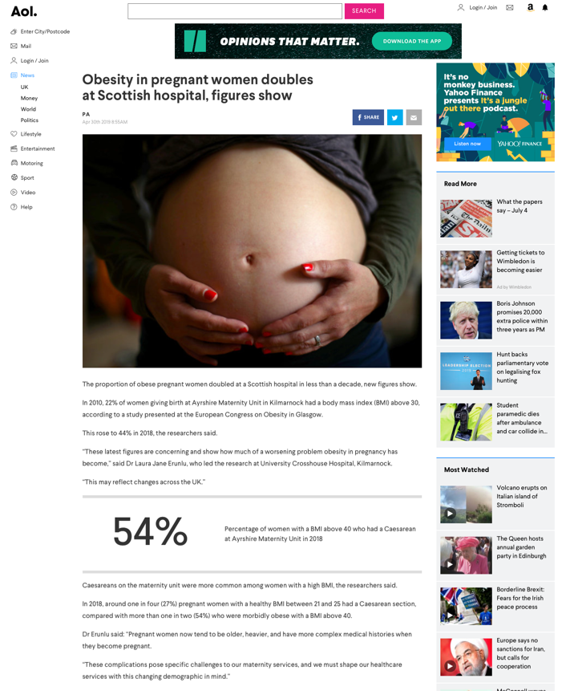
AOL.co.uk

Slide 49
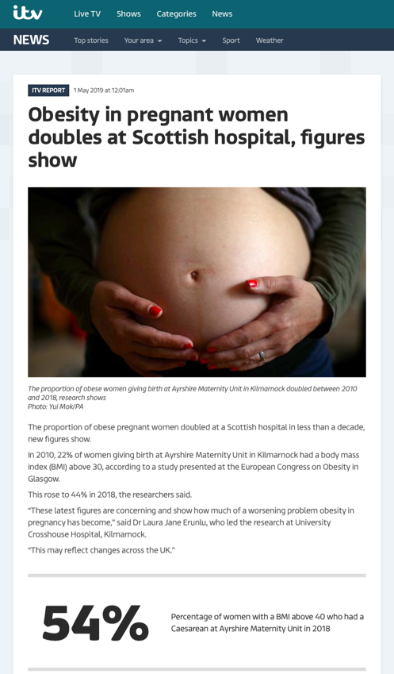
ITV

Slide 50
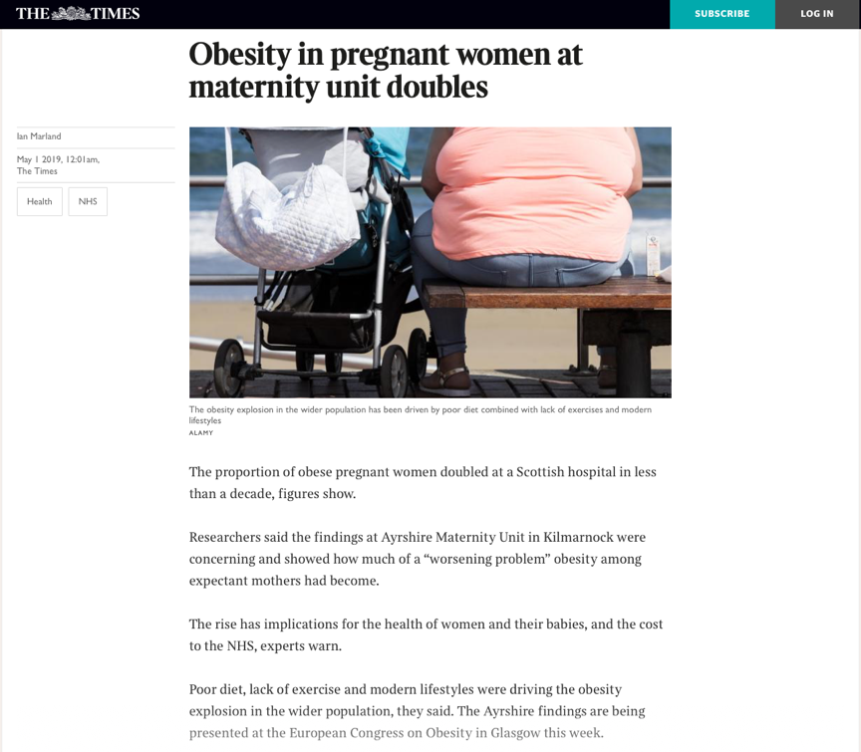
The Times

Slide 51
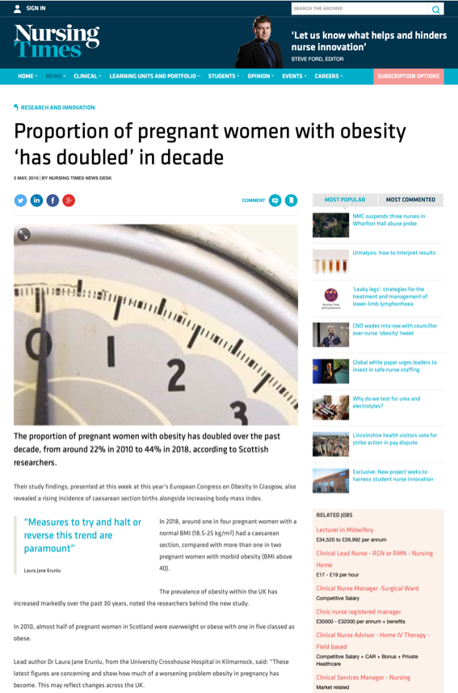
Nursing Times

Slide 52
Media highlights
Eating rice to tackle obesity

Slide 53
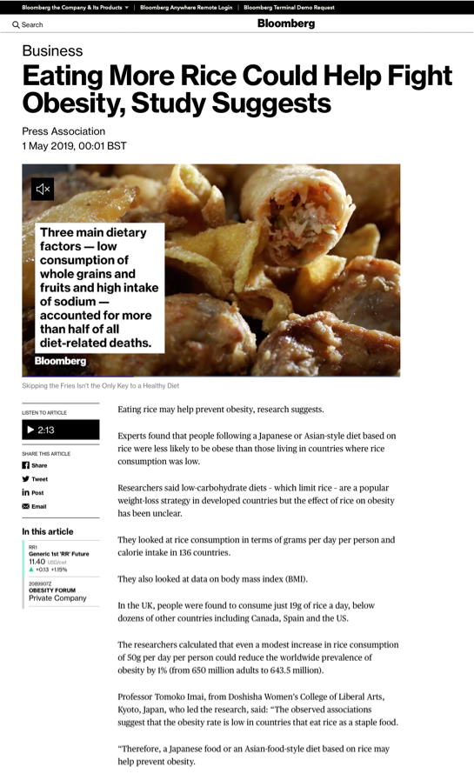
Bloomberg News (Press Association)

Slide 54
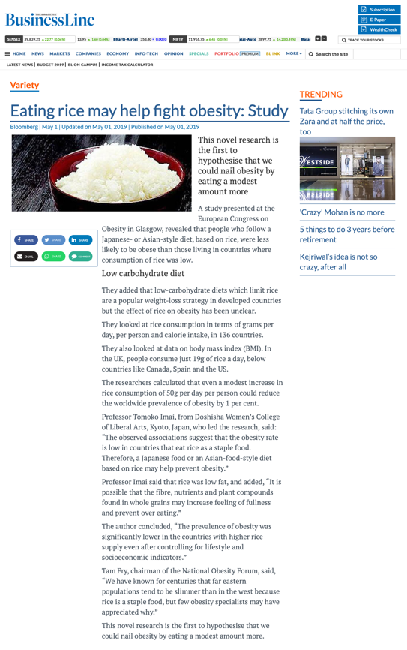
The Hindu

Slide 55
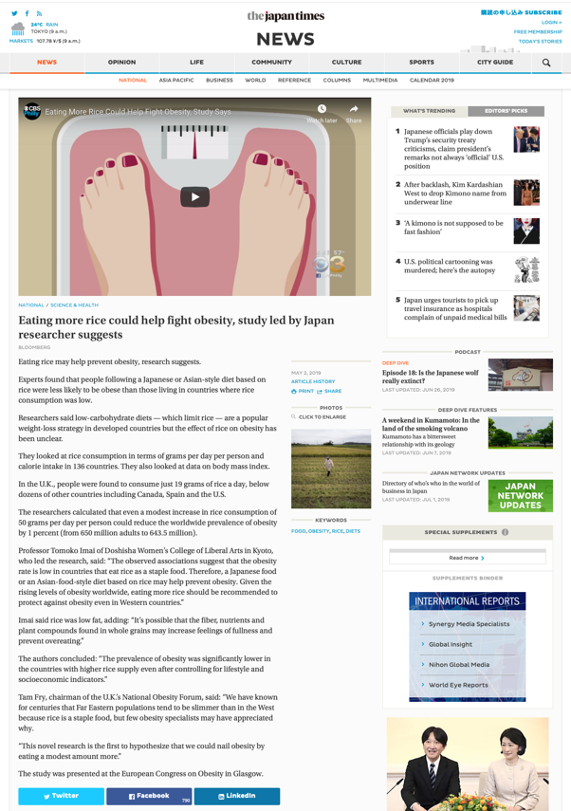
Japan Times

Slide 56
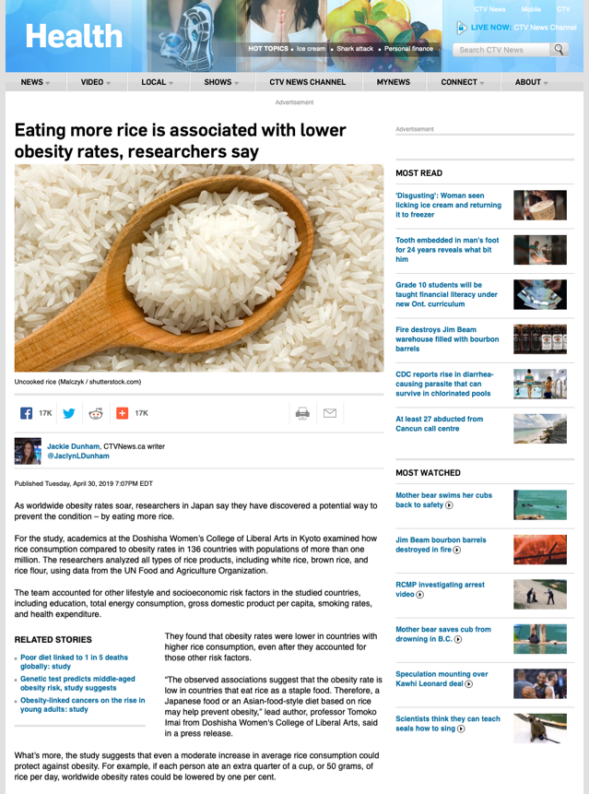
CTV News (Canada)

Slide 57
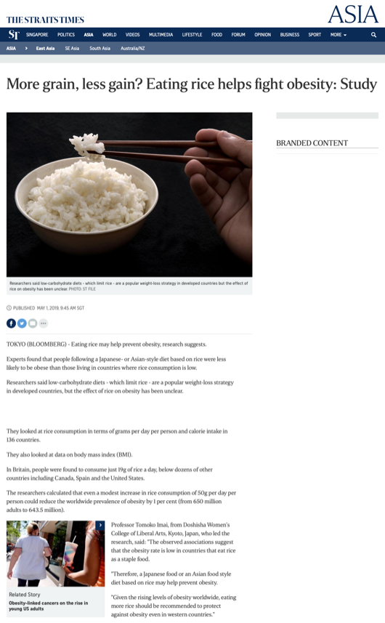
Straits Times (Singapore)

Slide 58
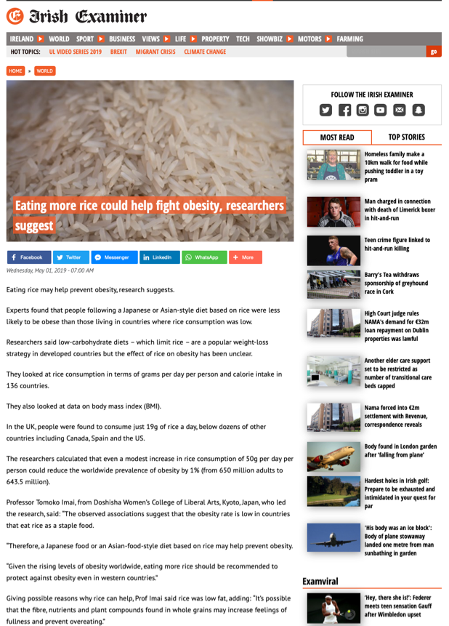
Irish Examiner

Slide 59
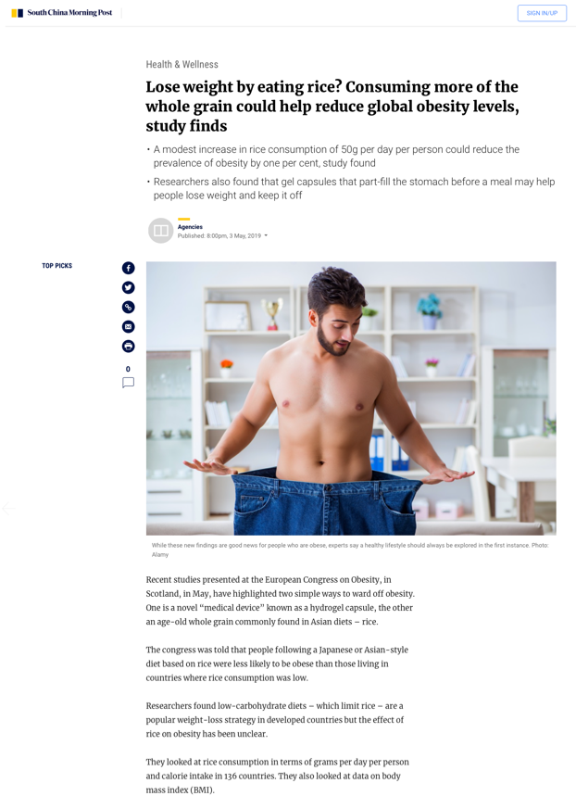
South China Morning Post

Slide 60
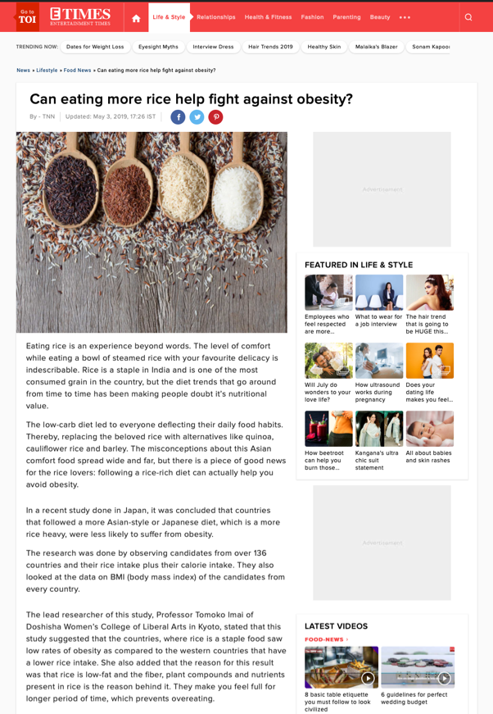
Times of India

Slide 61
Media highlights
Phenolic acid and breast cancer

Slide 62
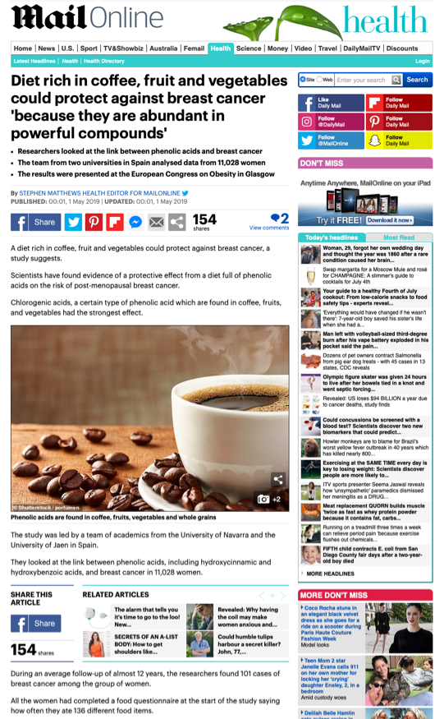
Daily Mail

Slide 63
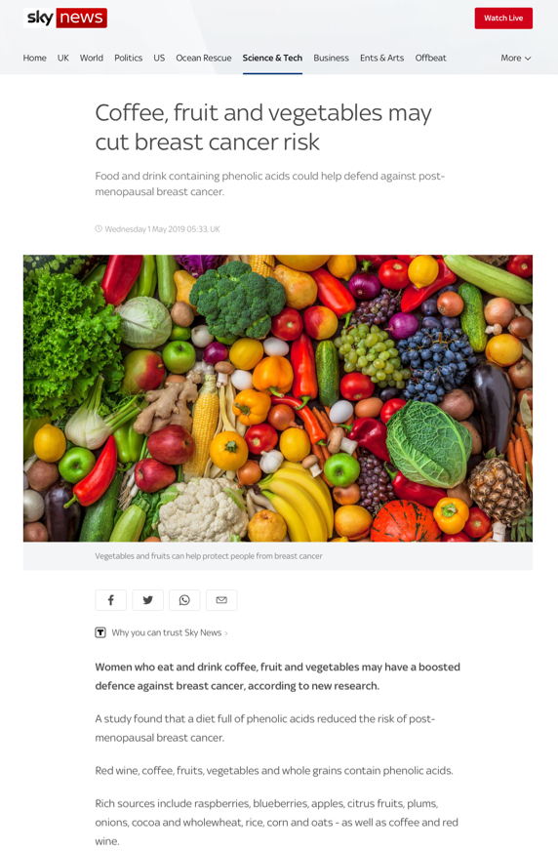
Sky News

Slide 64
Media highlights
Controlling obesity and preventing premature deaths (NOVO)

Slide 65
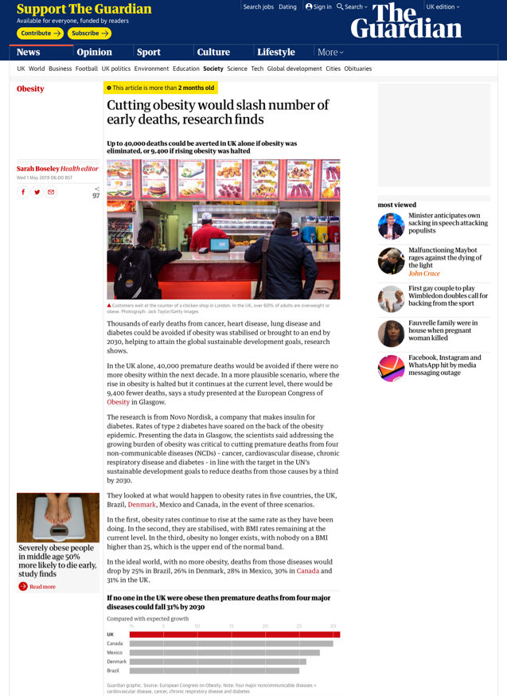
The Guardian

Slide 66
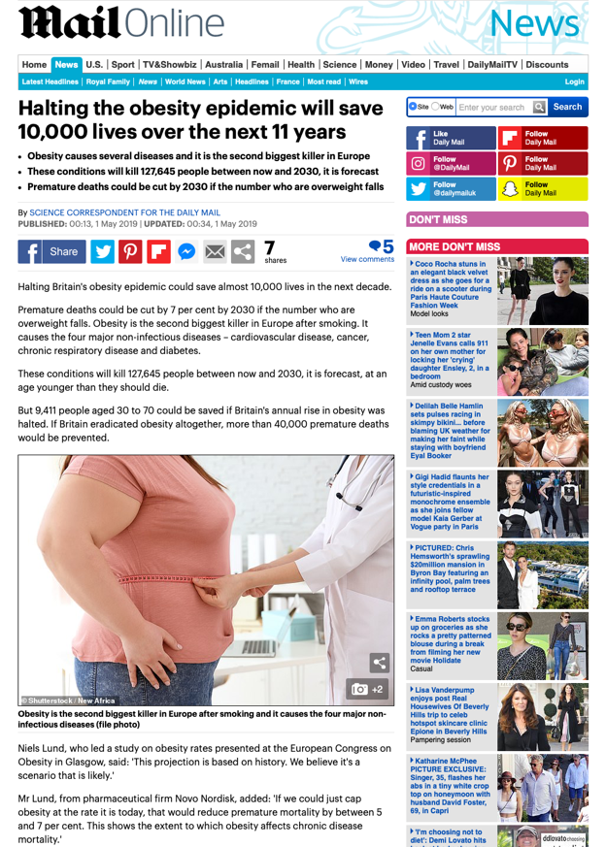
Daily Mail

Slide 67
Media highlights
PA newswire story – Leeds becomes first city in UK to lower its childhood obesity rate

Slide 68
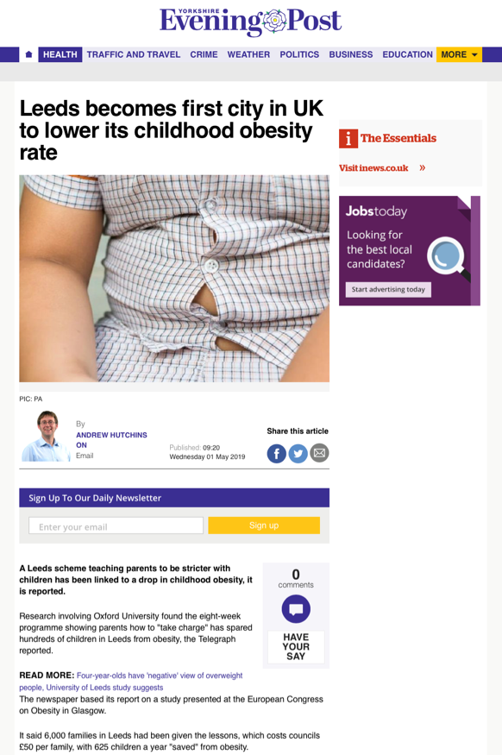
Yorkshire Evening Post

Slide 69
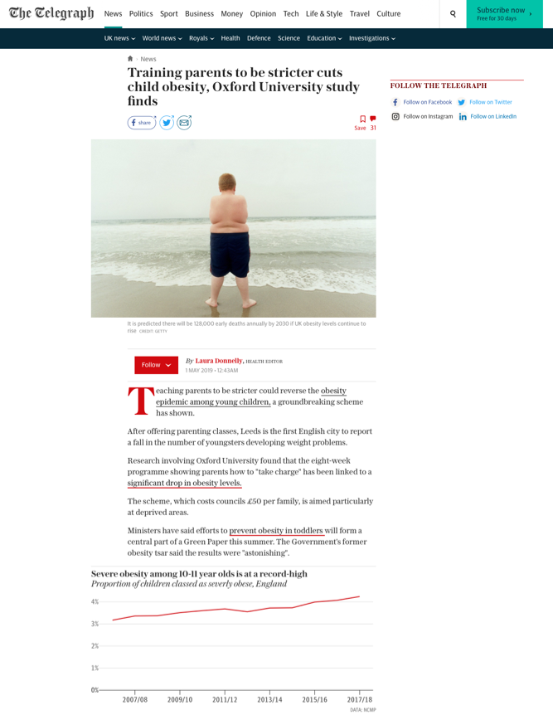
The Telegraph

Slide 70
The Telegraph (opinion)

Slide 71
BBC News

Slide 72
TVNZ (New Zealand)

Slide 73
Financial Times

Slide 74
Huffington Post

Slide 75
Tony Kirby PR Ltd

